Slide 1
Convolutional Neural Networks

Slide 2
Topics
Introduction to CNN’s
Motivation for using CNN
History & Literature
Implementation and Working Details
Code Review
Applications

Slide 3

What is CNN?
A specialized kind of neural network for processing data that has a known grid-like topology such as time-series data, image data etc.
Network employs a mathematical operation called “Convolution” in place of general matrix multiplication in at least one of their layers.

Slide 4
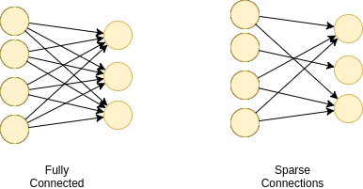
Motivation
Sparse Interactions: Unlike traditional neural network where every output unit interacts with every input unit, CNNs have sparse connectivity. Detects small, meaningful features that occupy only tens of thousands of pixels. Fewer parameters.
Parameter Sharing : The same parameter used for more than one function in a model. In CNN, each member of the kernel is used at every input.
Equivariant representations: If the input changes, the output changes in a same way. To use the same parameters to detect the local patterns at many locations in the image.

Slide 5
History and Literature
Neocognitron(1980) : The first architecture of its kind. The concept of feature extraction, pooling layers and convolution operation were introduced for recognition and classification.
LeNet-5(1989-1998) : It was developed for handwritten digit recognition task with 60K parameters.
AlexNet(2012): The first winner of Imagenet Dataset Classification challenge. It has 8 layers (5 convolutional layers and 3 fully connected). Introduced rectified linear unit(ReLU) as an activation function. 60M parameters in total.
ZFNet(2013): Same as AlexNet but few changes in hyperparameters. Significant decrease in the top-5 errors from 16.4% to 11.7%.
VGGNet(2014): Invented by Visual Geometry Group (at Oxford University).Worked on philosophy that by making CNN deeper, one can achieve lower error rate on classification challenge. Homogeneous architecture and smaller receptive fields. Total 138M parameters.
GoogLeNet(2014): Again Focused on deeper networks but with less parameters, less memory usage and computation. Total 22 Conv layers and total parameters reduced to 5M(12x lesser than AlexNet and 28x lesser than VGG.).
ResNet(2015): was developed by Microsoft team with an idea of “residual blocks” which are connected to each other through skip connections.

Slide 6
Implementation
Primarily, used in the analysis of images through pattern detection(edges,corners,shapes)
“Convolution” in CNN’s
special kind of linear operation wherein two functions are multiplied to produce a third function
It works by assigning importance to various aspects of the image using weights and bias
Structure of a CNN
Consists of 2 main parts
1) Feature Extraction (Pooling and Convolutional Layers)
2) Classification ( Fully Connected and output layer)

Slide 7

Convolutional Layer
Used to extract features from the input images
Convolution is performed using a filter of size M X M
The filters slide over the input image performing convolutions and creates a feature map using the dot products
Filters can detect complex features as we go deeper in the neural network

Slide 8


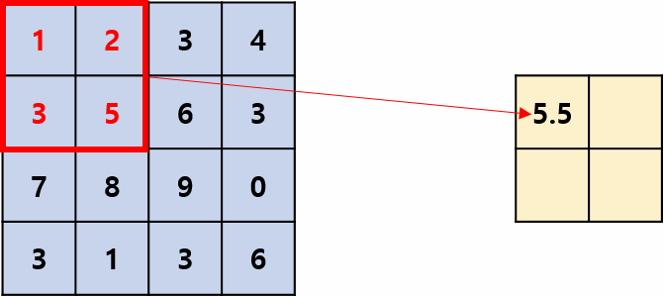
Average Pooling
Pooling Layer
Used to reduce the size of the convolved feature map to reduce the computations (Dimensionality Reduction)
Fully Connected Layer
The neuron applies a linear transformation to the input(flattened) vector through a weights matrix
A non-linear transformation is then applied to the product through a non-linear activation function f
https://glassboxmedicine.com/2020/08/03/convolutional-neural-networks-cnns-in-5-minutes/

Slide 9
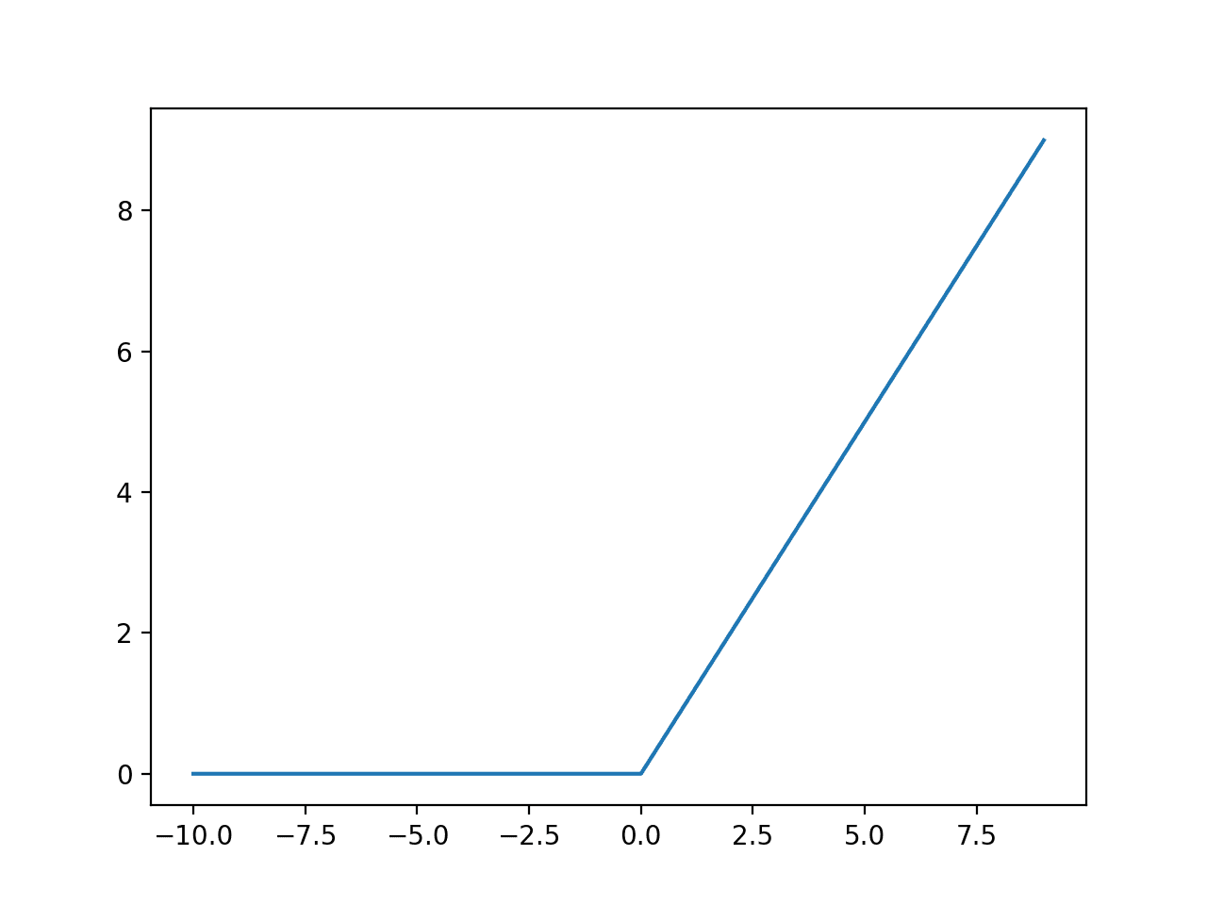

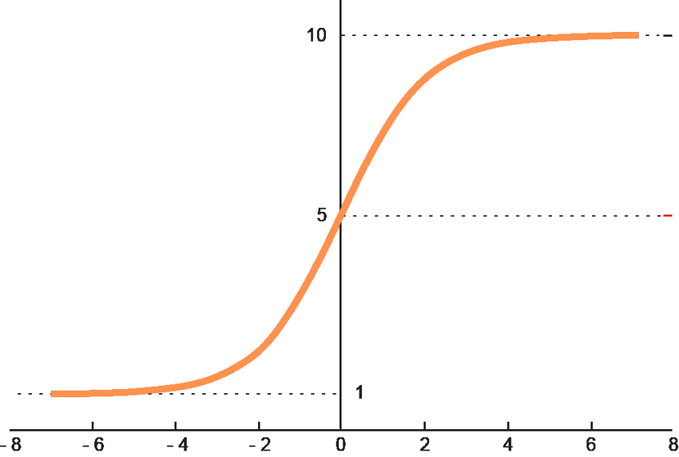
Activation functions
Used to add non-linearity to the network
Filters the information that needs to be propagated through the network
Different types of functions
Sigmoid - used for binary classification and outputs value as 0 or 1
Softmax - used for multiclass classification and outputs a vector of probabilities for each class
Rectified Linear Unit - Outputs the input directly if positive
Relu is used especially in the convolutional layers(Faster Computation, Gradient Descent does not get stuck)

Slide 10
Dropout Layer
few neurons are dropped from the neural network during training process resulting in reduced size of the model
Used to prevent Overfitting
Loss:
Method of evaluating how well the model is trained on given dataset.
A good model should have low value of loss function.
Cost function: An average loss over the training set.
Two loss functions for classification:
Binary Cross-Entropy : Used for binary classification
Categorical Cross-Entropy: Used for multi classification (more than 2 classes).

Slide 11
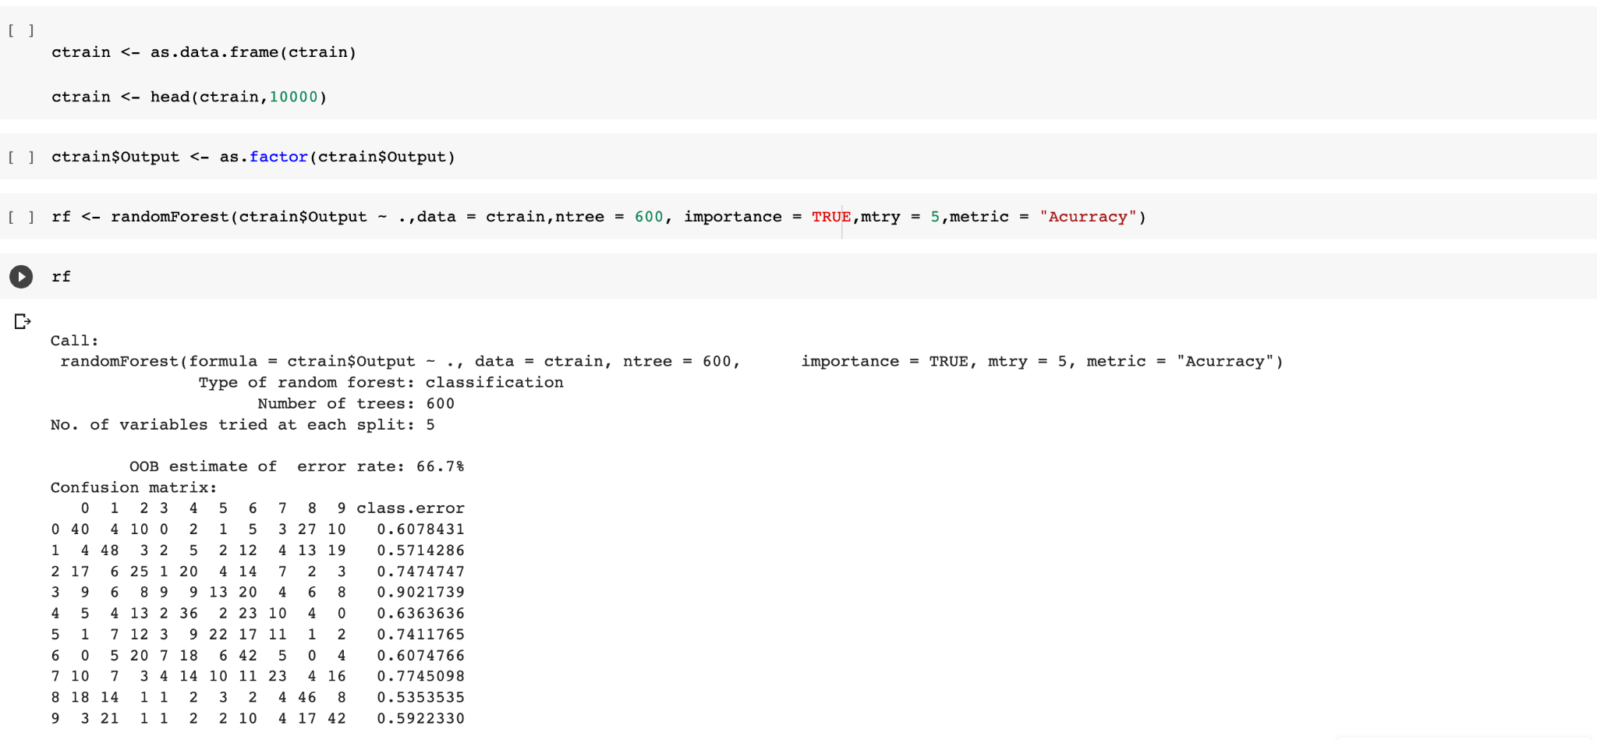
Classification using Random Forest
Random Forest vs CNN ?
Random Forests lack flexibility for feature extraction
Cannot take advantage of the repetitive nature of images (treats each pixel as a separate feature)
Does not exploit the latent patterns
In general the results obtained by CNN are much better

Slide 12
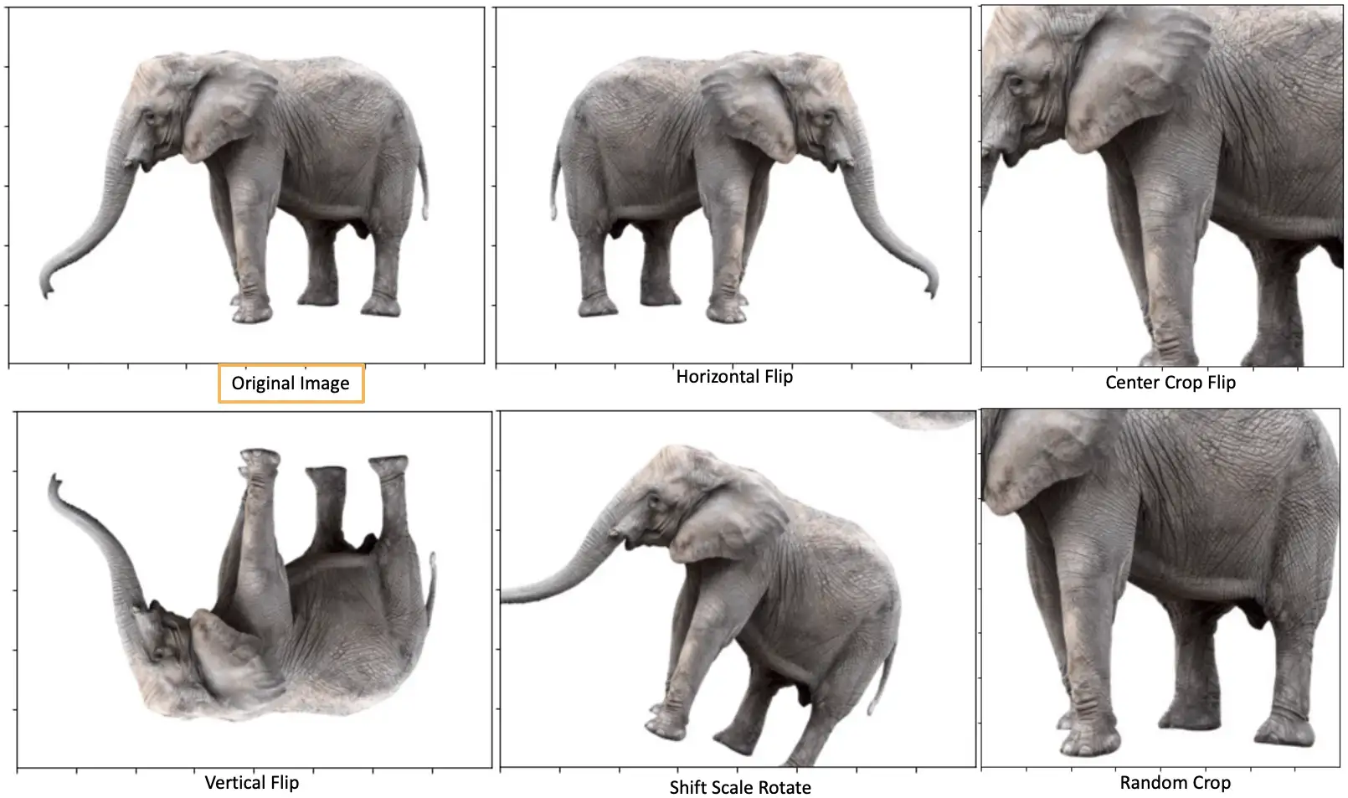
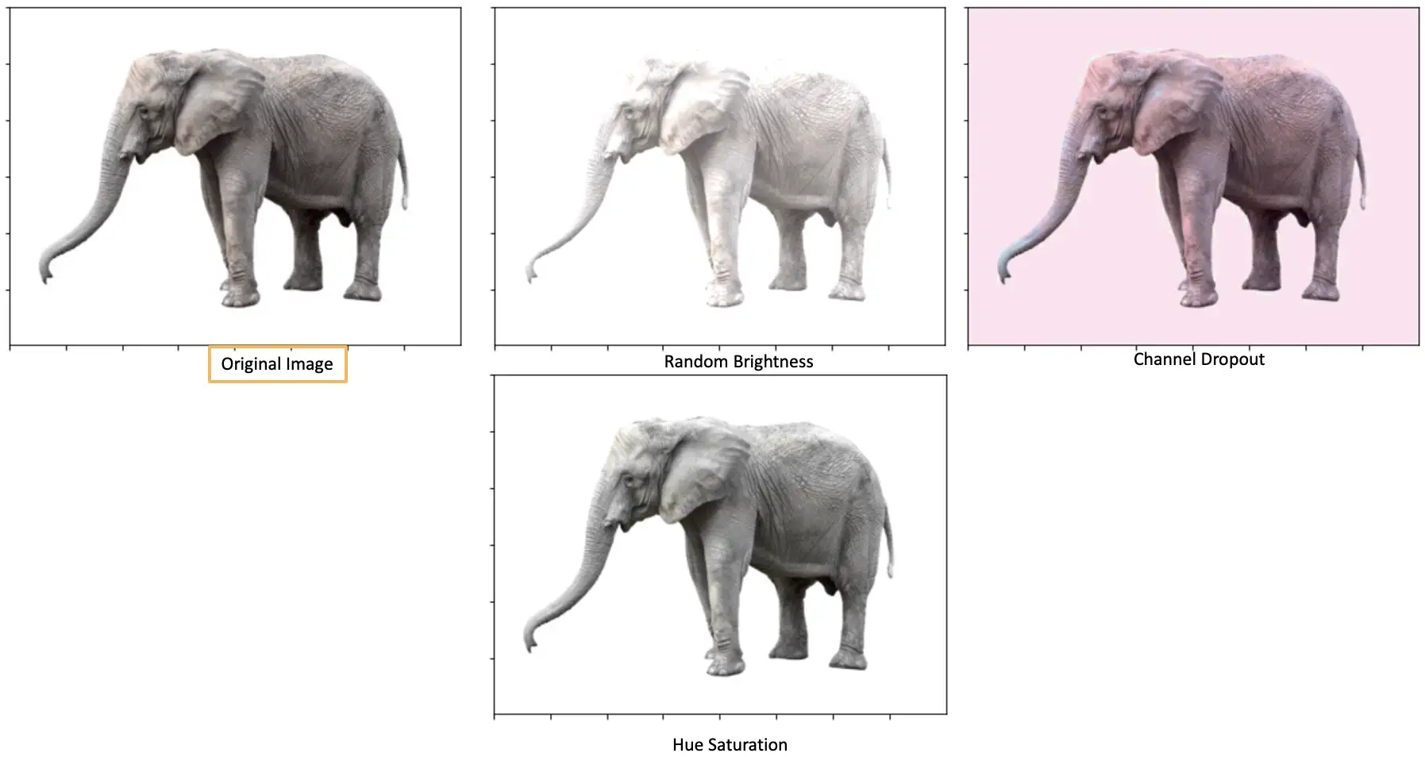
Classification with CIFAR-10 dataset using CNN
The dataset contains total 60000 images with 10 different categories of images.
Each image has 32x32 pixel size.
Train set - 50000 and Test set - 10000
Data Preparation: Normalization and categorical form (Binary values).
Example of Categorical data: [0,1,0,0,0,0,0,0,0,0]:- belongs to the 2nd class.
Augmentation: Data augmentation to increase the size of training set. Horizontal and vertical flip, rotating images (0 to 45 degrees), set brightness range (0.3 - 0.9), zoom in and zoom out (25%) .

Slide 13
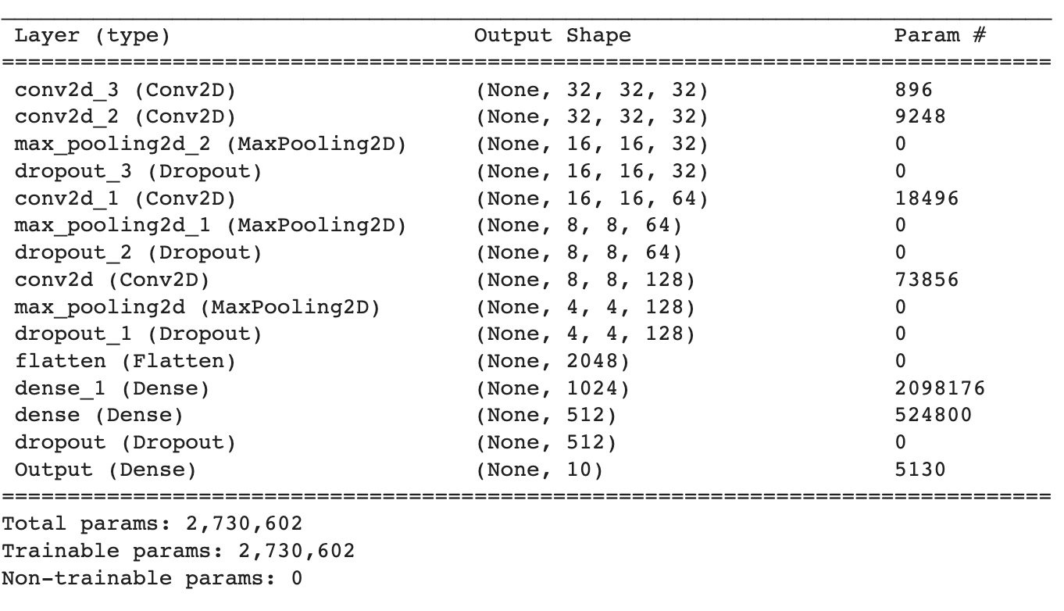
Model Building
2 convolutional layers to extract feature each with 32 (3x3) filters
Max Pooling
25% dropout
1 convolutional layer with 64 (3x3) filters
Max Pooling
25% dropout
1 convolution layer with 128 (3x3) filters
Max Pooling
Flatten
Dense layer with 1024 units
Dense layer with 512 units
25% dropout
Output layer with Softmax Activation function

Slide 14
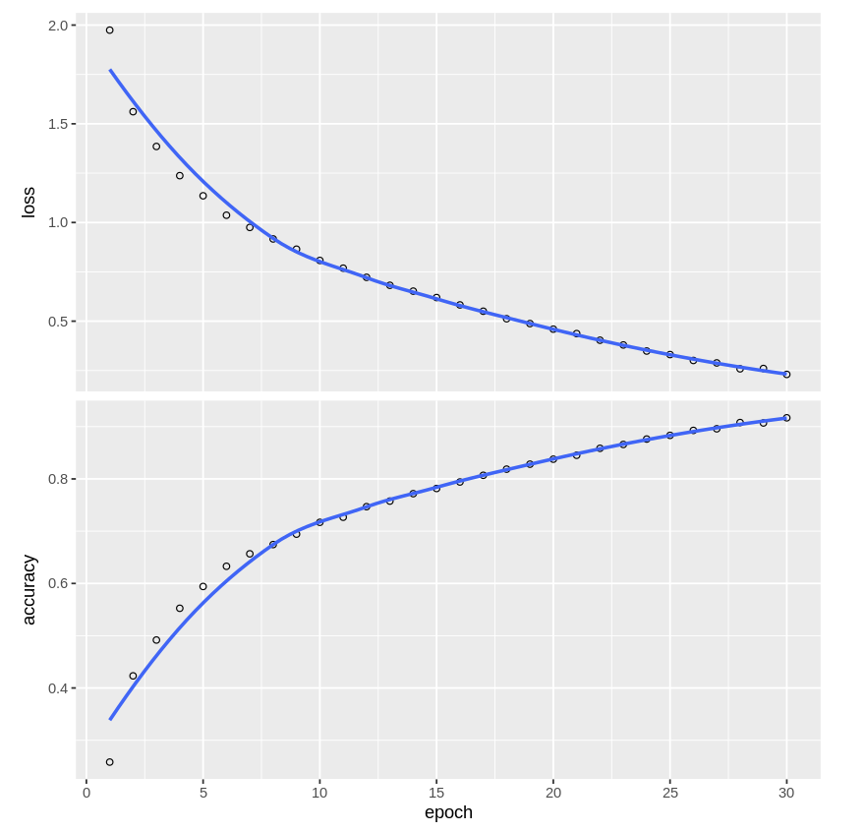
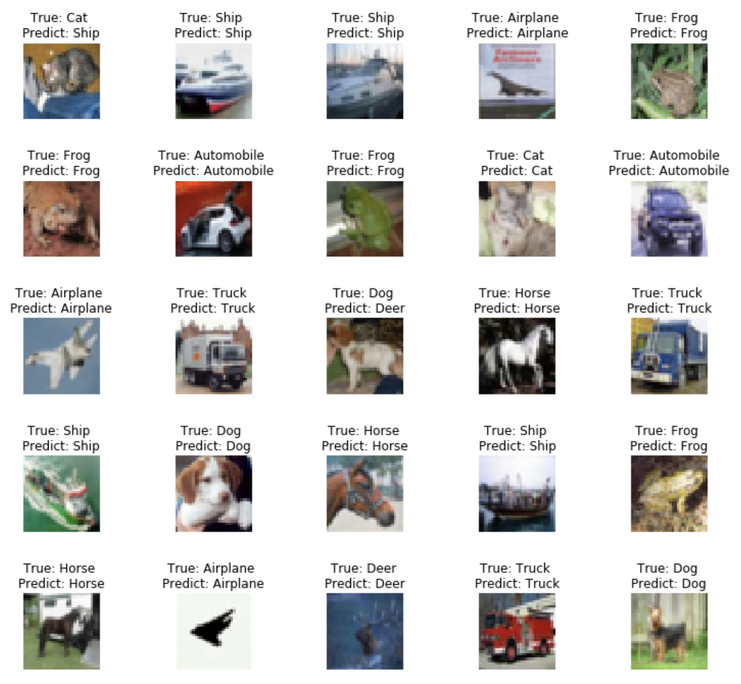
Results
Loss: 0.2303
Accuracy: 91.68%
Epochs: 30
Batch Size: 30
Model Evaluation
Test Accuracy: 80.12%

Slide 15
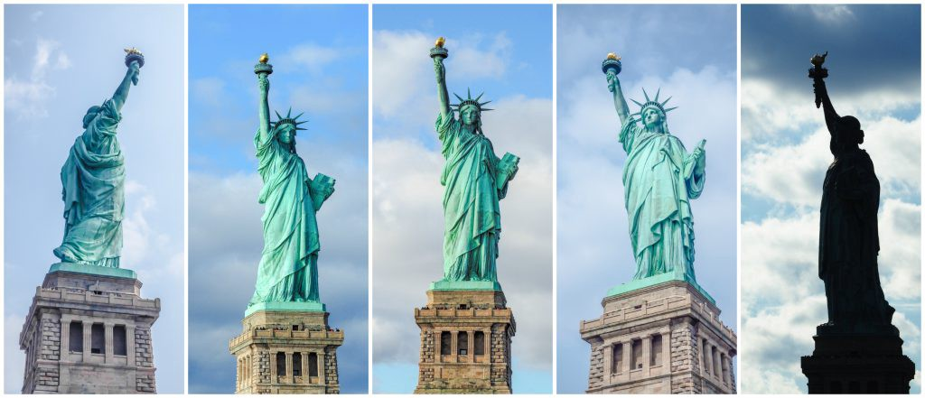
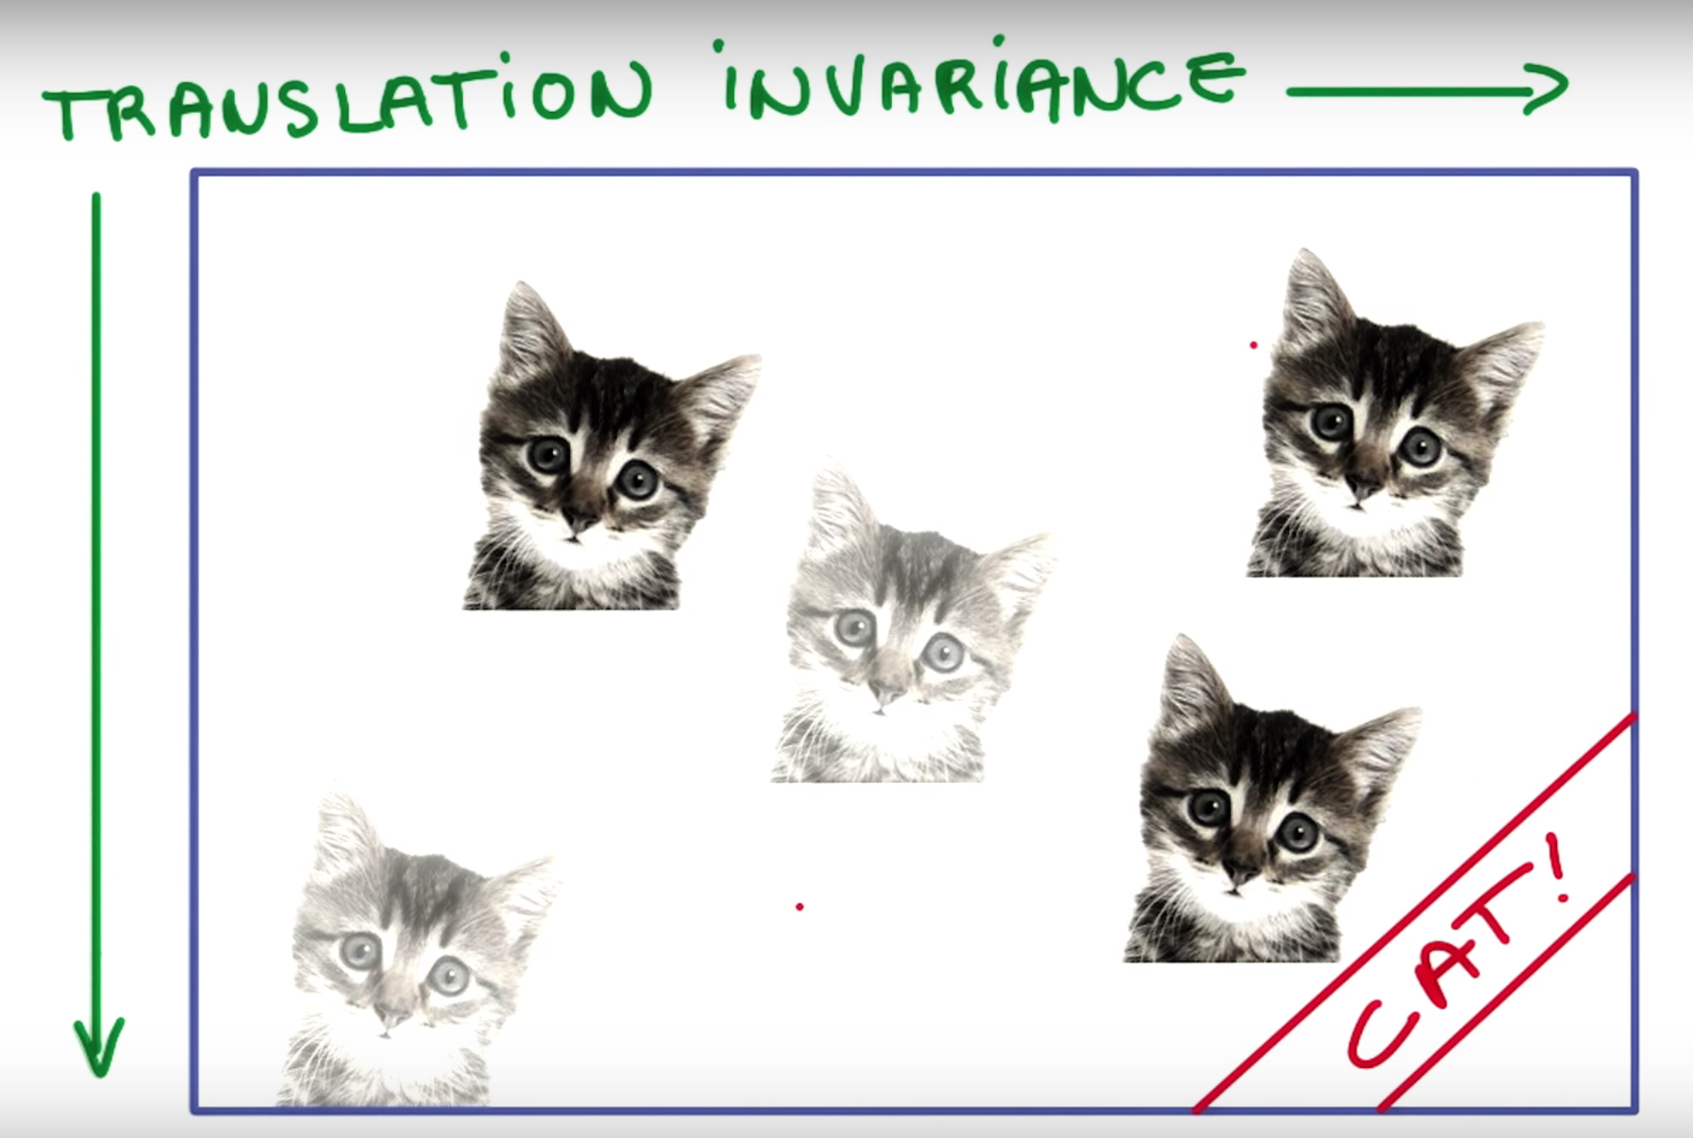
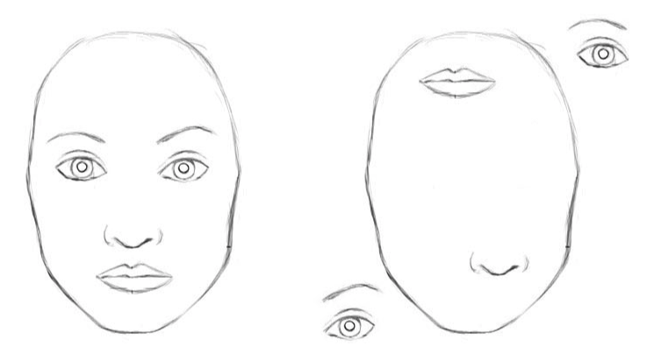
Limitations
CNNs do not encode the position and orientation of the object.
Max-Pooling layer

